Slide 1

Eco Drop
Project Topic : Eco drop – smart Sustainable water Bottling & Refill staion
Relevance : Tackling the global plastic waste crisis caused by single –use plastic bottles
Vision : To create a circular ,eco- friendly hydration system that reduces plastic waste while making clean drinking water more accessible

Slide 2
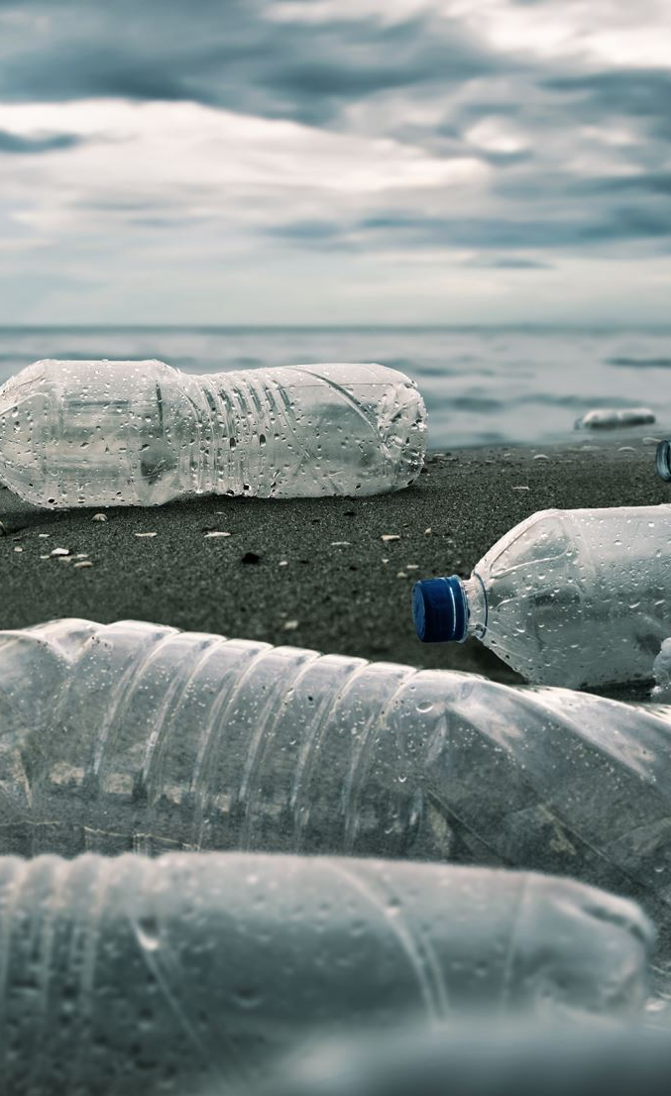
Problem statement
The problem
-1.3 billion plastic bottles are sold everyday world wide .
-less than 30% are recycled ; the rest end up in landfill or oceans .
- consumers want sustainable alternatives but lack convenient solutions .
Market Gap:
- Lack of affordable ,scalable ,and user-friendly refill infrastructure in urban areas

Slide 3
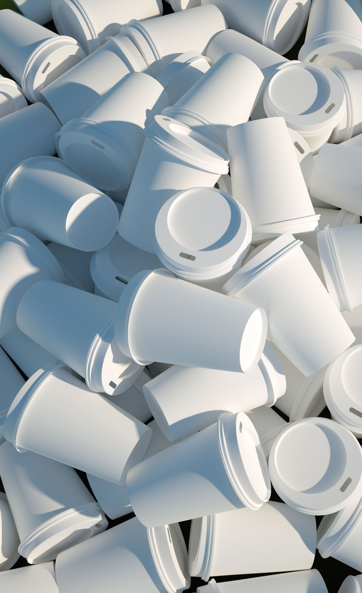
Market research
Target Audience :
-Enviromentally consious consumers ,urban commuters ,students , and tourists.
Industry Trends :
-Growing demand for sustainable packaging & Zero-waste products.
- EU plastic bans & sustainability regulations .
Competitor Analysis:
- Brands like SodaStream and refill initiatives exist ,but they are localized and not digitally intergrated

Slide 4
Market research
Consumer Needs:
- affordable access to clean water.
-Convenient refill points connected via mobile apps .

Slide 5

Solutions(ecodrop product / service)
Our solutions
-A network of smart water refill station across European cities.
- EcoDrop mobile app & Website to locate nearby stations , track water usage , and earn eco-rewards.
Unique features :
-Subscription – based reusable smart bottle with QR/NFC scan
-Gamification : users earn points for every refill.
-Real-time data analytics on plastic savings .

Slide 6

Solutions(Ecodrop product/service
Prototype Demostration :
- show Eco Drop website ->

Slide 7
Business model
Revenue streams :
1. subscription fee for smart bottles($ 5/month).
2.partnership with cafés,gym ,and public places hosting refill stations .
3. Eco-brand sponsorships & in-app advertising .
Value proposition :Affordable ,eco-friendly , and rewarding hydration .
Cost structure :
- Hardware (Stations & bottles )
- app development & maintenance .
- Marketing & operations

Slide 8
Marketing& sales strategy
Branding: "Refill, Reduce,Reward"
Promotion:
-Social media eco-campaign .
- partnerships with Universities & eco-communities.
- Incentives : free refills for first month .
-Direct-to- consumer via website /app.
-Retail partnerships (eco-stores,gyms).

Slide 9

Financial plan
Startup cost :$150,000 (app , prototype stations ,operations)
Revenue Forecast(Year 1):
-2,000 subscribers * $5/month =$120,000.
-partnership & ads = $30,000.
-Total : $150,000 ( breakven by end of year 1).
Funding Needs : $ 200,000 seed investment

Slide 10
Implementation Time line
Phase 1 (0-3 months ):Develop Prototy[e app & Website , secure first partners .
1
Phase 2(4 - 6 months) : Launch pilot program in Berlin with 10 Refill stations .
2
Phase 3(6 –12 months ) :Expand to other German cities .
3
Phase 4 (Year 2+): scale across major European cities
4

Slide 11
Conclusion &q&a
Summary : Eco Drop is a sustainable , tech – driven solutions to eliminate single – use plastic bottles.
Potential : Scalable across Europe ,supports green regulations , and fosters eco-conscious habits.
Closing line :"With Eco drop ,Every refill counts towards greener future ."
Q & A

